Slide 1
Agent Modeling on Covid-19
EN 250
Blake Holland, Theodore Jagodits, Isabelle Rivera, Christopher Rudel
I pledge my honor that I have abided by the Stevens Honor System.
Notes:
Izzi: 2-4
Chris: 5-11
Blake: 12-17
Theo: Code demonstration

Slide 2
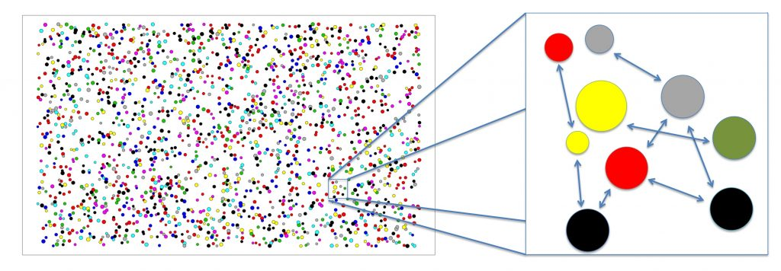
Introduction
COVID-19 has been impacting us all globally, nationally, and locally. The challenges we are dealing with expand across many domains.
Our model aims to display the effects of the virus with and without social distancing.

Slide 3
Background on COVID-19
The Coronavirus Disease (COVID-19) is thought to spread mainly through close contact from person-to-person in respiratory droplets from someone who is infected. People who are infected often have symptoms of illness. Some people without symptoms may be able to spread virus.
Since COVID-19 is a new disease, research is still ongoing on how it spreads and the severity of illness it causes.
Social distancing is the best way to reduce the spread of the disease.

Slide 4
Model Summary
Our take on Agent-Based Modeling to try modeling the spread of COVID-19.
Creates a matrix of people that move around. A certain percent of the population starts infected. A certain amount of the population is social distancing.
We run for a certain amount of time steps so that people can interact with each other.
Notes:
500 iterations

Slide 5
Healthy
Sick

Slide 6
Variables and Constants
Age - From 1 - 100 years
Social Distancing - Boolean True or False
Location - index location inside matrix - arbitrary
Sick - Boolean True or False
Sick Days - # of Days that person has been sick
Initial Sick Population - percentage
Population Density - how densely populated the matrix is with people

Slide 7
Assumptions
Age is constant during the simulation.
Nobody dies of old age.
The age is distributed evenly across population.
Population can be reinfected.
Notes:
Current knowledge of coronavirus reinfection is mixed, so we allowed the population to become reinfected

Slide 8
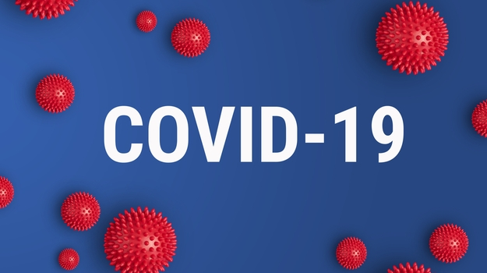
Setup
Build a matrix that players/agents populate.
Every time step agents move around and have a chance to infect each other.
Some percentage of population starts infected.
Notes:
.1% of the population starts sick

Slide 9
Properties
The more players are around that are infected, higher chance of getting sick.
Social Distancing:
If the player is social distancing, there is a very low chance that it will be infected.
Not all of the population is social distancing, so the population will get infected.
Age: The older the player, the higher chance they have of dying.
Notes:
Social distancing infection rate: about .01%
Non-social distancing infection rate: 21%

Slide 10
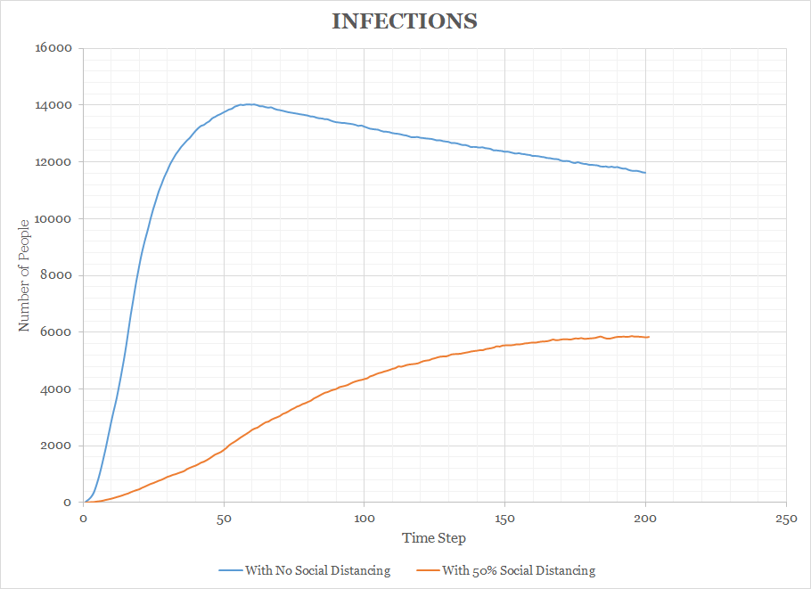
Data and Results

Slide 11
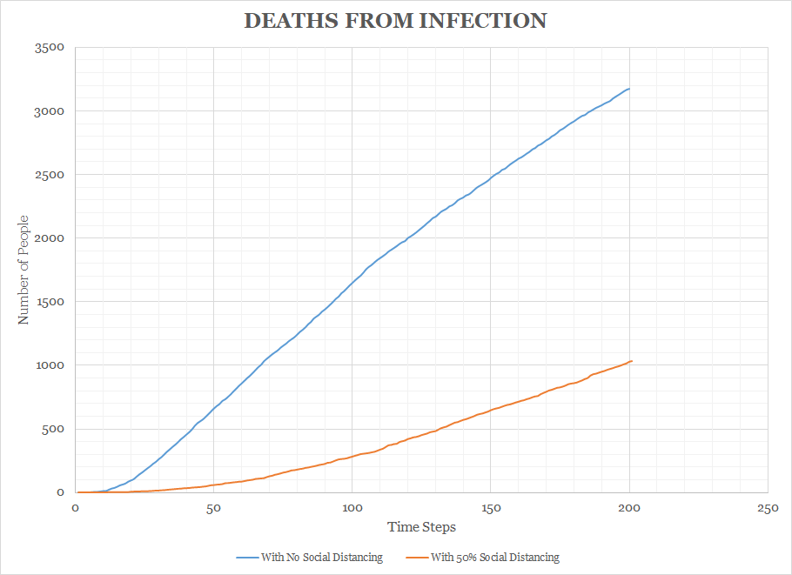
Data and Results

Slide 12
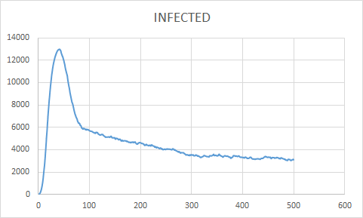
No social distancing

Slide 13
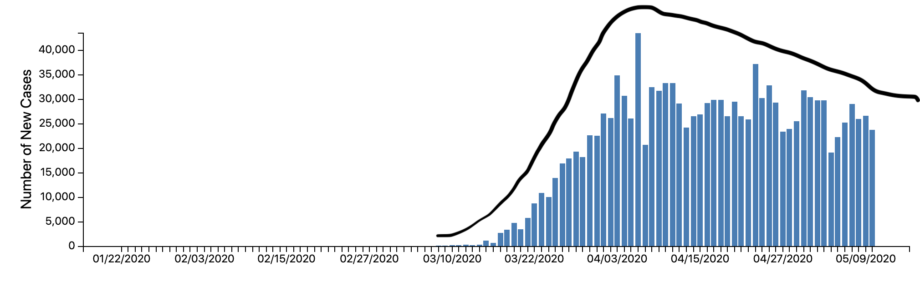
CDC Graph of Infections in United States

Slide 14
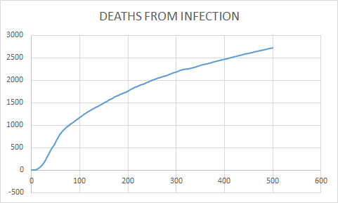
Fatalities

Slide 15
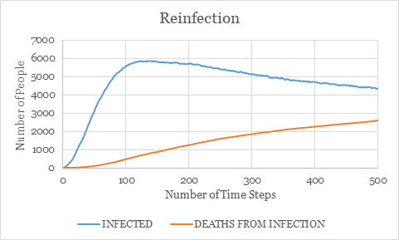
Reinfection with 50% Social Distancing

Slide 16
Results
The infection rate for 0 social distancing is 5 times higher than 50% social distancing.
The death rate is to 10x lower than for 50% social distancing.
For 500 iterations, the infections and deaths only slowly taper off.

Slide 17
Conclusions
Social Distancing dramatically decreases/flattens the curve.
With people having the chance of being reinfected, the curve does not drop off quickly as expected for infected or deaths for 0 social distancing.
With 50% social distancing, the death rate does not rise very quickly and stays relatively low.

Slide 18
Possible Improvements
Create a hotspot, where people gather - emulate groceries, banks etc.
Create different communities - People can travel between communities.
Option to model different types of disease - COVID-19, Flu…
Visual Representation of the program - pictures, models, graphs
Genetic Evolution - disease adaptation and transformation

Slide 19
Code Demonstration

Slide 20
Citations
https://www.worldometers.info/coronavirus/coronavirus-age-sex-demographics/

